Slide 1


Application Management Best Practices with Tivoli Solutions
Xerox ACS PSG
Daniel Needles – Principal Consultant, NMS Guru
Ping Wu, Ph.D. – Sr. Enterprise Architect, ACS a Xerox Company
Notes:
Pulse 2011
B-1522: Application Management Best Practices with Tivoli Solutions at ACS PSG
Session Format: Breakout Session
Where: Las Vegas, MGM Conference Center - Level 1 - Room 108
When: Wed, 2/Mar, 08:00 AM - 09:00 AM
Co-presenters: Ping Wu, Affiliated Computer Services (ACS)Session number: 1522
Title: Application Management Best Practices with Tivoli Solutions at ACS PSG
Abstract: The Affiliated Computer Services Payment Solutions Group (ACS PSG) is the VISA/Mastercard network for many government programs that support millions of benefit recipients. The viability of ACS PSG depends on full transparency regarding the health and well-being of the end-to-end solution: networks, devices, and applications. This session will explore best practices developed while replacing an in-house monitoring system with Netcool, IBM Tivoli Monitoring (ITM) and IBM Tivoli Composite Application Manager (ITCAM), as well as upgrading the existing business processes to ITIL.
What will your audience walk away with? 3 key bullets:
Experience derived best practices for implementing Netcool with ITM/ITCAM
2. How to implement ITIL processes leveraging this tool set
3. How to determine key metrics to enable full transparency and enforce concrete SLAs
Level: All
Audience
What key roles/titles will this session target? Systems Administrator; Software Configuration; CIO; Executive; Systems Analysis; IT Management; Design & Development; Enterprise Architecture Manager; Quality Assurance; Business Analysis; Application Program Management; Project Manager; Operations
Management
Industries: Government; Financial Services (Financial, Banking, Insurance)
Does this session contain confidential information? No
Contact information
E-mail address: dneedles@gmail.com
Name: Daniel Needles
Company name: NMS Guru
Phone: 5126276694
Country: United States
Geo/Region:
Category: IBM Business Partner
Comments/Additional requirements:
guru@nmsguru.com Daniel Needles NMS Guru IBM Business Partner
ping.wu@acs-inc.com Ping Wu Affiliated Computer Services (ACS) Client

Slide 2

Agenda
Phase 0: Planning Overview:
  Application Management Strategies
  Monitored - ACS EPPIC Application
  Monitoring Challenges & Requirements
  Monitoring Overview & Project Schedule
Phase 1: ITM
Phase 2: ITCAM
Phase 3: OMNIbus and ITIL Enablement
Phase 4: Impact and event enrichment, suppression, and SLA enablement
Phase 5: TBSM and Service Monitoring
Questions? Need Help?
Notes:
Agenda follows the phases of the project with the addition of some strategic level slides. The slides are divided into four sets:
Slides 3-4 target: executives, management, and folks affected by such an implementation.
Slides 5-10 target: project management, architects, and top down implementers.
Slides 11-24 target: architects, consultants, engineers, and other bottom up implementers.
Slides 1-2,26 targets everyone.

Slide 3
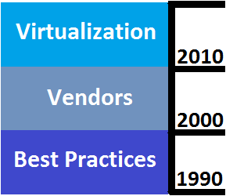
Application Management (Issues)
Application Management has a high rate of failure but is perceived as a commodity. What makes it hard:
  Globalization: Wal-Mart mode
  Industry: Age of Vendors
  Standards: Security posture
  Solution: Nuances to implementation tendencies
  Organizational: Call center verses development verses executive personalities
Notes:
Strategic Posture is the most overlooked and critical aspect to any Application Monitoring project. Application Management is hard with a high rate of failure but perceived as a commodity – this makes strategy more important than tactics. Think about what that means. Many factors contribute:
Globalization - Wal-Mart model - sell cheap commodities cheaply. This affects all aspects from hiring, pressure to not plan, transaction posture (instead of relationship), vendor interactions, intolerance of sausage making, and the need to sell internally.
Industry. There have been 3 ages:
1990’s – Best Practices
2000’s – Vendors
2010’s Virtualization
Though we are in the age of virtualization there is always a 5-10 year lag between creation and adoption of these practices. The Vendor age is dominated by a lack of money for planning, but there still exists a need for custom configuration creates a litany of issues. As a result vendors perform POCs with all encompassing tool architectures. Essentually best practices are internalized as large vendors have gobbled up the smaller fish. Additionally, “non-partisan” views are no longer unbiased as a result of the drying up funds. This is similar to the pattern among the news networks. Gartner, Forester to Network World all have become publicity generating engines and must be partial in order to have a business model that will survive.
Standards - Issues around protocols and discovery with a security posture. This is primarily seen in the area of discovery where a central entity is expected to pry out of every element: 1) How to communicate, 2) What “should” be monitored. This is an unrealistic expectation.
Solution - Recent integration of corporate cultures, jargon, technologies. Tools only 10% of solution. (90% is Organizational structure, Business Processes, and Knowledge Management.) Tendency: focus on tools, boil the ocean, see everything as nails, and the coffee maker syndrome.
Organizational - Quality orientation of call center personalities: Red must mean red, green must mean green. If not, the will be dropped and trust is very difficult to reestablish. Perception that monitoring is a commodity and success is common and easy. This is enforced by the lack of internal POCs and thus sales/marketing more strongly influences perception which sets expectations extremely high. Development is time centric with interesting interplays and management is cost centric with added complexity.

Slide 4
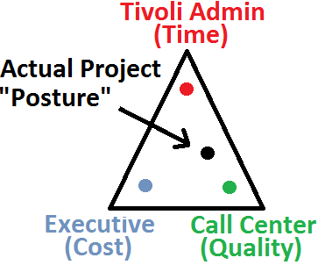
Application Management (Solutions)
Project Posture
  Don’t Skimp on Planning and Listening
  Reconcile Early Expectations to Realistic Outcomes
  Transparency – Internally Don’t Hide the Sausage Making
  KISS (Grounded Iterations) over Sexy Home Runs
  Creativity over Early Judgments
  “Manage” over “Control”
  Quality over Scope
  Customer over Vendor
  Organization over Tools
Self Governance:
  Know Thyself
  Nothing in Excess
  Do the Right Thing
Notes:
Project Strategic Posture:
Don’t Skimp on Planning and Listening - identify customers and goals early. Seed expectations. The key here is to understand that emotional alignment takes much longer than mental. And emotional alignment of departments takes much longer than emotional alignment of individuals. So start the internal marketing (especially with the customers) at the beginning and do not let up EVER.
Reconcile Expectations to Possibilities - Almost always customer expectations don't match reality at several locations. Mentally, you can move the organization quickly, emotionally it takes time. So planting seeds early is a must. A primary goal is for the monitoring culture to take root.
Transparency – Due to high failure rates, internal and external communication leads to better results as long as outside governance can be managed.
KISS (Grounded Iterations) over Sexy Home Runs - Home runs don't win games especially with huge gaps. “Infinite in all Directions” by Freeman Dyson
Creativity over Early Judgments – “Getting to Yes: Negotiating Agreement Without Giving In” - by Roger Fisher and William Ury. Judgments KILL the creative process and also add conflict and shut down communication. Suppress judgment early in the project to assure the path will lead to the global maximum rather than a local maximum.
“Manage” over “Control” Much of the project is outside control of the implementer. Learning to manage this is the key to success. Also individuals and organizations need to feel “pain” – it is the only path to growth and maturity and long term health.
Quality over Scope - Addresses quality orientation of call centers and support (red means red and low tolerance of procedure changes) assuming price is fixed.
Customer over Vendor - Due to high failure rates, this posture is needed. If projects are left to manage themselves via project plans, meetings, tickets, etc, holistic issues will lead to failure 90% of the time.
Organization over Tools – The tendency is to ignore adoption. However, tools are only as useful as how the existing organization alters their business processes and knowledge management to adopt them and own them. Since this is mostly emotional, it can be very difficult and is mostly internal sales and marketing.
Self Governance (Strategic Posture of the Self):
Know Thyself. - Addresses steering clear of the many black holes. Coffee pot analogy – discussions over small budgets are lengthy, but large budgets generally not so. There is a tendency to boil the ocean due to the interconnectivity of everything. Also conflicts among executive, implementors and customers are common due to the focus on budget, schedule, and quality respectively. Also know where the products stand – Good core features with demands in the integration points (including licensing, installation, single sign on, event state integration, etc.)
Nothing in Excess. – This point focuses on the primary black hole that occurs. Scope creep occurs because of: customer expectations, excessive unknowns, and the holistic-ness of the solution as well as the difficulty to say no, especially in this global transactional economy.
Do the Right Thing - Much harder than it sounds. Either it is too easy to say “No” or it is easy to get defensive rather than constructive with Customer Complaints depend on which end of the spectrum you fall. Also lessons learned require a change of “stance” and saving face may not be desirable or possible for the benefit of the project. If done right many people will feel uncomfortable – because usually that is what is needed to get the right things done – the only path for growth whether people or organizations is adversity. In psychology this dynamic is described as the drama triangle. The only role among victim, rescuer, perpetrator that can destroy the drama triangle and move the discussion forward is the perpetrator. This can be incredibly hard. The pressure on the consultant is 1) rescuer, 2) victim.

Slide 5
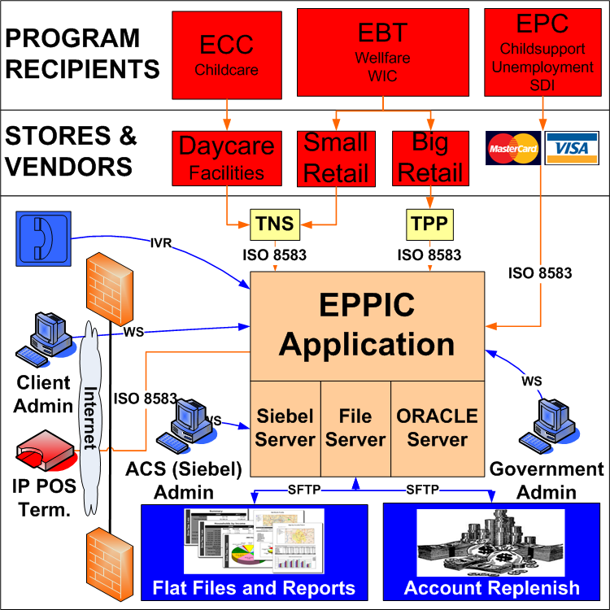
ACS EPPIC Application Overview
Notes:
ACS Provides for State Programs and their recipients what VISA/Mastercard provides for Banks and their Card holders.
EPPIC is an end-to-end service that consists of many layers of transactions, application, systems, and networks. The diagram describes the high level interactions of the program recipients, government programs, stores and vendors, ACS Xerox, and the end-to-end solution.

Slide 6
EPPIC App Mgmt Challenges and Monitoring Requirements
Challenges
  Legacy home-grown monitoring tool lack of end-to-end system and application visibility
  Ops team not always able to take proactive actions to prevent incidents from occurring
  Sometimes the 3rd party customer noticed a problem before the Ops team
  70+ state benefit programs running live for 40+ state clients
Requirements
  Migrate legacy monitoring tool to enterprise-class monitoring tool
  Provide end-to-end visibility for systems & apps.
  Enable proactive app mgmt and prevent incidents.
  Supply consistent SLA management.
  Non-intrusive & non-disruptive to the end-to-end EPPIC solution

Slide 7
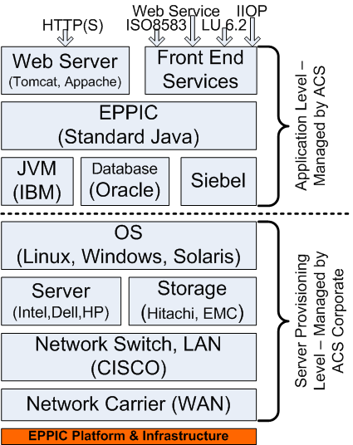
Monitoring Solution Overview
Project Work Scope:
  Legacy => Netcool
  Add ITM/ITCAM
  Integrate ITM & Netcool
Length – 1 year
IBM Resources – 2,000 hrs:
  1 Project Manager
  1 Netcool FTE
  1 ITM/ITCAM FTE
ACS Resources:
  1 Executive Sponsor
  1 Internal Project Manager
  3 FTEs (Existing Dept.)
Notes:
High level view of the project’s: work scope, length, contract hours, and available ACS resources. Also this introduces what the Tivoli solution is being applied to: EPPIC. EPPIC is an end-to-end solution that involves: network, systems, applications, and transactions. Further it involves organizational forces, the strongest being the fact that the network and system infrastructure is owned by a separate, corporate group.

Slide 8
Project Schedule
Monitored
Monitoring | Scope
Phase | Product | Capability
5 | TBSM | SLA monitoring | 40 States roll out
4 | Impact | CMDB event enrichment
3 | OMNIbus | ITIL processes impl.
 | OMNIbus | APP legacy monitoring
 | OMNIbus | APP log parsing
 | OMNIbus | File Server monitoring
 | OMNIbus | Oracle Grid integration
 | OMNIbus | OS/Svr/NW/Storage Corp mon. integration
2 | ITCAMfT | APP ISO8583 trx tracking
 | ITCAMfA | Oracle DB monitoring
 | ITCAMfA | Siebel App monitoring
1 | ITM | APP Mbeans monitoring
 | ITM | OS monitoring
Notes:
The project was a 5 phase approach with new levels of functionality being rolled along with additional states and programs being added to the fold at each step. Expanding Tivoli solution into new sites as well as new levels of functionality created the value of the solution as well as the overall work of deployment.

Slide 9
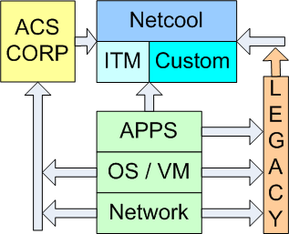
Tivoli at ACS (Approach)
Two “Environments” (2 Netcool & 1 ITM Server)
Segregate: OMNIbus, Impact, and TBSM & WebGUI.
OMNIbus for
authentication
Single tier
OMNIbus
Leverage legacy
events & structures
Licensing (‘nuf said)
ITM to OMNIbus
integration
Notes:
The first step was to architect an overall solution based on the major components involved. These consisted of 5 areas:
EPPIC end-to-end solution (Green)
ACS Corporation Monitoring of the Network, Hardware, and OS (Yellow)
Tivoli
Tivoli ITM
Tivoli Netcool
Customer Code
Legacy Monitoring

Slide 10
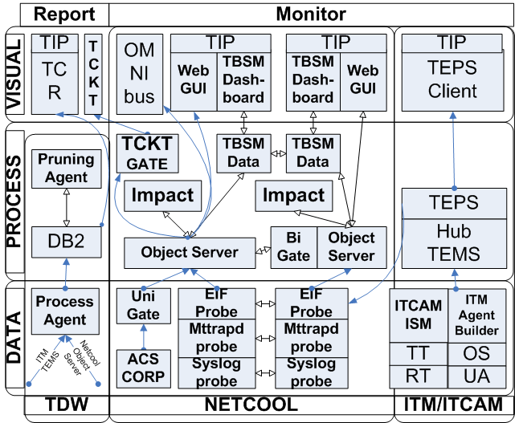
Tivoli at ACS (Products)
Notes:
At a high level these are the products used at ACS.
Notice what is missing
UNIGate HA
OMNIbus to ITM updates
Notice Expensive Choices:
Latest and greatest products and integration WebGUI
Cross product integrations (Netcool, ITM, ITCAM, TCR, legacy)
Best Practices
Shared Parts
portal (TIP )
Authentication and authorization (OMNIbus in this case.)
Mindful of Licensing, Installation, and Integration.
Install TBSM/WebGUI, Impact, and OMNIbus under separate users.
Research Fix Packs and talk with other early adopters before taking the plunge.
Licensing can be non trivial depending. Press Sales to clearly define what was purchased.
Event Flow Management
Reject events early, mindful of historical reporting
Expect, detect, and manage unexpected events (Solutions tendency is to go blind.)
Focus on actionable events
Multiple ways to do the same thing, so solidify corporate standards
Generalized rule in EIF probe as a work around, ITM $msg unique settings – culture differences
Complex behavior: Impact, OMNIbus, Probes, Custom Scripts.
KISS
Simple over complex implementations
Iterate a component at a time
Bend to reality
ITM to OMNIbus integration (one way, not two.)
Load balancing difficult to impossible on TBSM/WebGUI with shared TIP
Impact HA questionable, use implied HA and load balancing instead
Design and As-Built Documentation

Slide 11
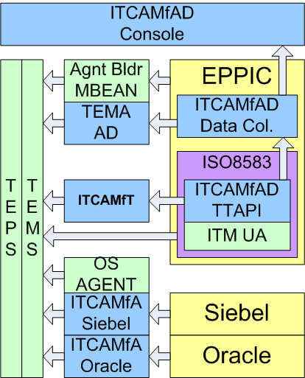
ITM/ITCAM - New Sources
New Collection Sources
Integration Complexity:
  Multiple acquisitions:
    ITCAMfT - IBM
    ITM - Candle (2004)
    ITMCAMfAD Cyanea Systems (2004)
    Netcool Micromuse (2005)
    Netcool Impact Goldman Sachs (1998)
  Custom sniffer code
  Distinct jargon and philosophies
TDW – Future repository
Notes:
PARTS:
ITM Agent Builder => mbean. Same can be done for logs, but not quite flexible enough in the case of EPPIC log.
ITM UA (Universal Agent) provides transaction data rather than statistical/rollup values like TTAPI
ITM OS Agent
ITM/ITCAM Tivoli Enterprise Management Agent (TEMA)
ITCAMfAD (Application Diagnostics – J2EE (or J2SE in this case) / WebSphere
ITCAMfT (Transactions)
ITCAMfAD Data Collector forwards to Candle’s ITM and Cyanea’s ITCAMfAD, a more development console
ITCAMfA Siebel (Important bugs to work around.)
ITCAMfA Oracle (OracleGrid was used instead for political reasons.)
BEST PRACTICES:
Understand rather than memorize jargon.
Plan for adoption NOW.
Start looking for CMDB / discovery
Leverage IBM support on issues early
Advocate of customer posture
All parties must feel pain to learn and evolve into the solution.

Slide 12
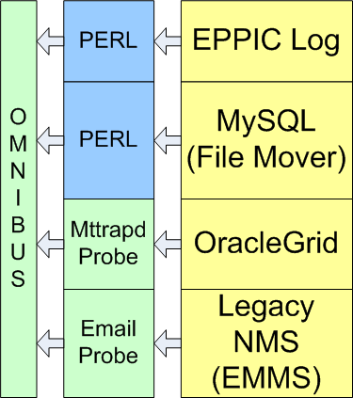
Custom Code – Other Sources
Leverage Legacy Sources
  EPPIC Application Log
  Legacy NMS (EMMS)
Integrate Existing NMS
  OracleGrid
  SNMP Traps
Alternative Approaches
  Instead of ITM Agent Builder, PERL with DBI to parse File Mover Application Logs
Notes:
BEST PRACTICES
Custom code is often easiest and most flexible to implement, but hardest to maintain. Use custom code when
Legacy integration
Problematic integration for various reasons (i.e. ITM Agent Builder Application Log Parsing)
Political issues (OracleGrid.)

Slide 13
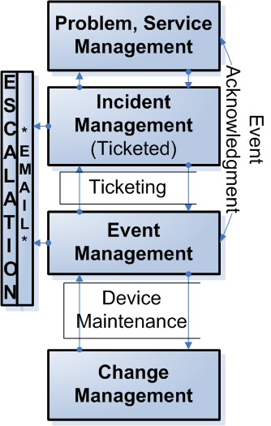
OMNIbus and ITIL Workflow
The Tivoli Architecture is 10% the rest is:
  Organizational Structure
  Business Processes
  Knowledge Management
  Other Tool Architecture
Strategy: Empathy, plant seeds, cultivate questions, thinking and eventual ownership.
Tactics: Iterative release of ITIL v3 enhancements automating Existing Work Flows.
Notes:
ITIL is naturally top down with focus on organization, people, business processes and knowledge management. Start with the emotional / human based elements as these transition much slower than the logical and technology based elements. Further, understanding and integrating with existing processes and tools is critical here in order to foster adoption and ownership by the organization. As an organization adopts ITIL, TQM, or other process centric approaches, ownership becomes a bigger issue.

Slide 14
Work Flow Elements
Ticketed Queue
  Ticket (Manual) / Ticket Close (Manual)
Acknowledge Queue
  Acknowledge / UnAcknowledge Event
Maintenance Queue
  Maintenance / UnMaintenance Device
Escalation Queues
  Escalation Email
  Both stale unhandled events and very stale ticketed events.
ACS Corporate Integration
Notes:
At ACS we automated the most critical and mature business processes and for the most part extended and streamlined what was already in place.

Slide 15
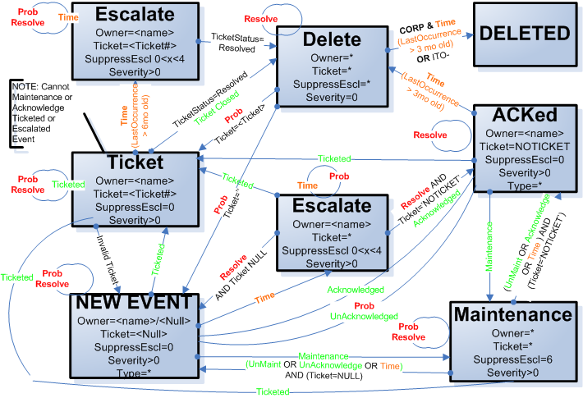
Work Flow End-To-End
Notes:
Each work flow state has an equivalent operational state represented by a distinct conglomerant of data fields. In addition the Delete state holds on to events from ACS corporate so that if the event returns the local ACS state information such as group and user as well as severity is preserved.

Slide 16
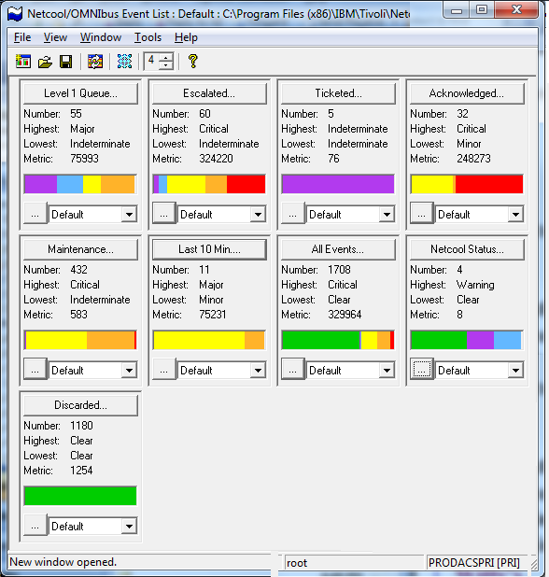
Complementary Views and Filters
Queues
  Level 1
  Ticketed
  Acknowledged
  Maintenance
  Escalated
  Discarded
Temporal
  Last 10 Min
  All
Tivoli Status
Notes:
Each work flow state also has a representative filter and view. Additional temporal and tivoli status filters are provided.

Slide 17
Ticketing
Tools: Ticket (Manual), Close Ticket (Manual)
Daemon: Close ticket, Keep status in sync
Fields: Ticket, TcktSeverity, TcktStatus, TcktUID, TcktGID
Event Lifespan Mirrors Ticket
Escalation on Stale Tickets
Cannot place in Maintenance or Acknowledge

Slide 18
Acknowledgement
Tools: Acknowledge and UnAcknowledge
Fields: Ticket with ‘NOTICKET’ rather than Acknowledge Flag
Automation
  Update Deduplication to unset Acknowledged event for problem alerts
  Automation PSGAgeOut added to clear stale Acknowledged events
Acknowledge events do not Escalate

Slide 19
Maintenance
Tools:
  Device Maintenance,
  Device UnMaintenance
  Device Manual Maintenance
Node centric.
Table: Alerts.PSGSuppress - keeps state
Automation: PSGSuppress – periodically tags events, untags events, and expires maintenance rows in Alerts.PSGSuppress.

Slide 20
Escalation
Tools: Out of the box escalation.
Fields: SuppEscl, PSGSuppressEscl
Automations:
  PSGEscalation escalates stale Ticketed and stale new events via a three tier three retry model
  New_event and deduplication automations altered to initialize or reset timers on new or resolution events
Database Table: Alerts.PSGEscalate tracks outstanding escalations three tiered escalation state
PERL script used to:
  Aggregate and throttle escalations
  Periodic report of outstanding escalations

Slide 21
ACS Corporate Integration
Uni-directional Updates, not Inserts
Filter out uninteresting events
Free up: Severity, OwnerUID, OwnerGID
  Map workflow fields to New Fields
  Initialize fields with ACS Corporate values
Preserve state outside event death by holding onto cleared ACS Corporate events (i.e alter DeleteClears)
Extend monitoring to overlap with ACS corporate monitoring

Slide 22
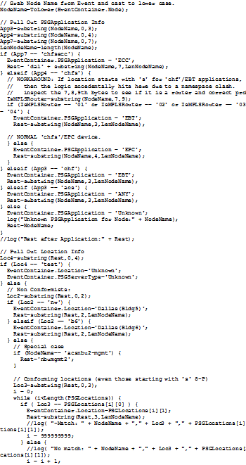
Impact Overview
Enrichment
  CMDB
  Hostname
  Individual SLA (Faults, Performance)
Correlation
  Leverage “Maintenance” automations
Synthetic Events
  Aggregate statistics synthetic events
Actions (None)
Notes:
Impact was used for specific enrichment, correlation, and synthetic event creation activities. The majority of time was spent on design and development. The implementation was quick followed by extended testing and debugging of macro behavior.

Slide 23

Impact Best Practices
Complex Behavior Choices
  Impact & Java Extensions
  OMNIbus automation and tables
  Probe Properties and Lookups
  Custom shell script, PERL, or JAVA
Best Practices
  Be wary of Impact HA.
  Over plan and check.
  Don’t push Impact.
  Single OMNIbus Service and slower updates
  Separate Impact Install
  Avoid hibernate
  Adjust JAVA runtime memory
Notes:
The choice for complex behavior (finite automata) within the Netcool suite is between:
Impact with or without JAVA extentions
OMNIbus automations and tables
Probe properties and lookup files (with outside administration)
Custom code integrations (PERL and JAVA primarily)
Best Practices
Be wary of Impact HA and as an alternative use a poor man’s HA/load balancing.
Over plan and check. Debugging in Impact is challenging (as it is with any 4th generational language.)
Don’t over tax Impact.
Back off of the default 3 second updates.
Install in a separate user from OMNIbus and TBSM. This circumvents TIP/WebSphere conflicts and Installer Issues.
Avoid hibernate due to memory management issues.
Increase JAVA memory runtime parameters.

Slide 24
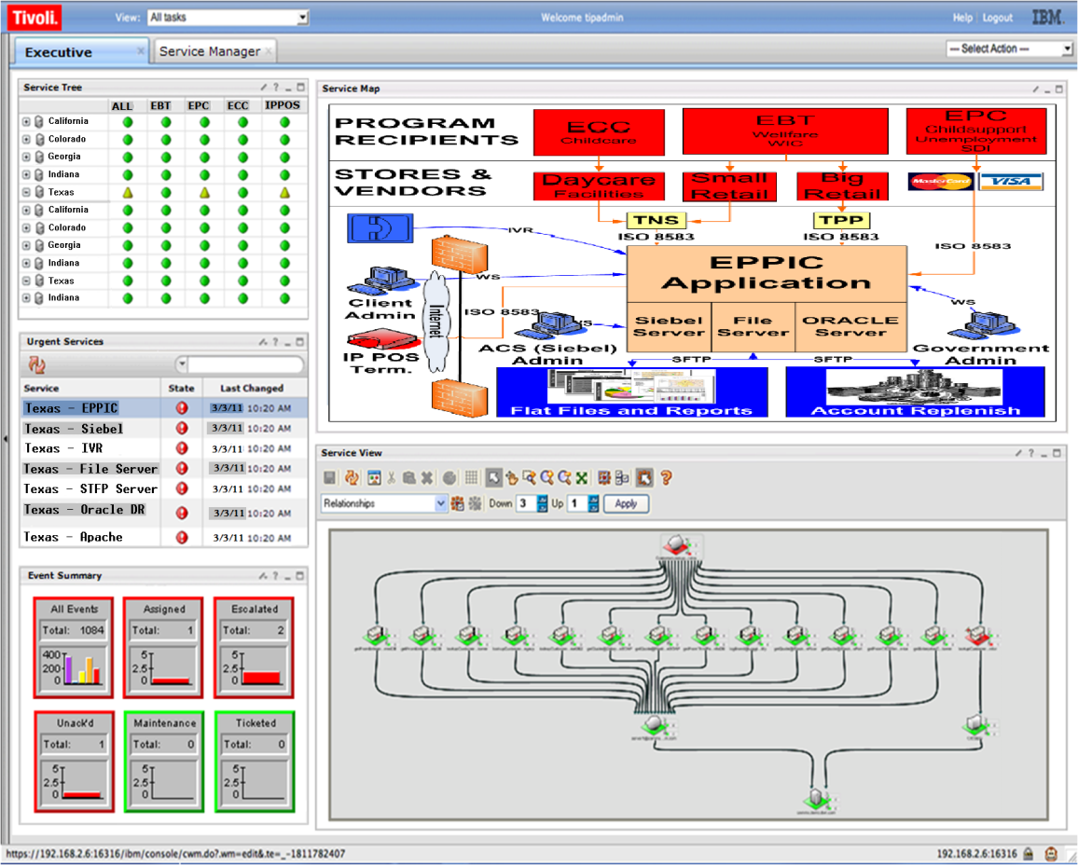
TBSM
Primary Customer Facets: executive, customer advocate, support (level 2 & 3), support (level 1)
Business Service Management at a glance
SLA Monitoring
Critical outage rollup
Logical and Geographical representation

Slide 25
Future Plans
Historical Repository and Reporting
CMDB Expansion and Integration
Configuration Management
Automated Discovery (ITNM, TADDM, CMDB)
Agent-less Web Services and Element Monitoring (Tivoli Netcool ISM)
Monitor of Monitors

Slide 26

Questions? Need Help?
Daniel Needles
  Phone: 512.627.6694 / Skype: Daniel Needles
  LinkedIn: http://www.linkedin.com/in/danneedles
  Facebook: http://www.facebook.com/daniel.needles
  Email: guru@nmsguru.com or dneedles@gmail.com
Ping Wu
  Email: Ping.Wu@acs-inc.com

